Slide 1


Slide 2

Agenda
What is Astro?
Astro vs. Traditional SPAs
Installing & Creating new Astro Project
Astro Project Structure
Layouts
Routing
Components
Islands Architecture
Who uses it
Conclusions
Resources & More Information

Slide 3

What is Astro?
Astro vs. Traditional SPA

Slide 4



Slide 5
Astro vs. Traditional SPAs
Astro vs. Traditional SPA

Slide 6
Astro vs. Traditional SPAs
Faster load times with zero JavaScript by default
Flexible framework support
Great for SEO and content-heavy sites
Astro vs. Traditional SPA

Slide 7
Installing & Creating new Astro Project
Astro vs. Traditional SPA

Slide 8
Create Astro Project
Astro vs. Traditional SPA
npm create astro@latest my-astro-project

Slide 9
Astro vs. Traditional SPA
Astro Project Structure

Slide 10

Astro vs. Traditional SPA

Slide 11

Layouts
Astro vs. Traditional SPA
A system in the Astro framework that allows developers to create reusable page structures. Layouts are defined as components and can be used across multiple pages

Slide 12

Components
Astro vs. Traditional SPA
Components are reusable building blocks that allow you to create modular and dynamic parts of a website

Slide 13
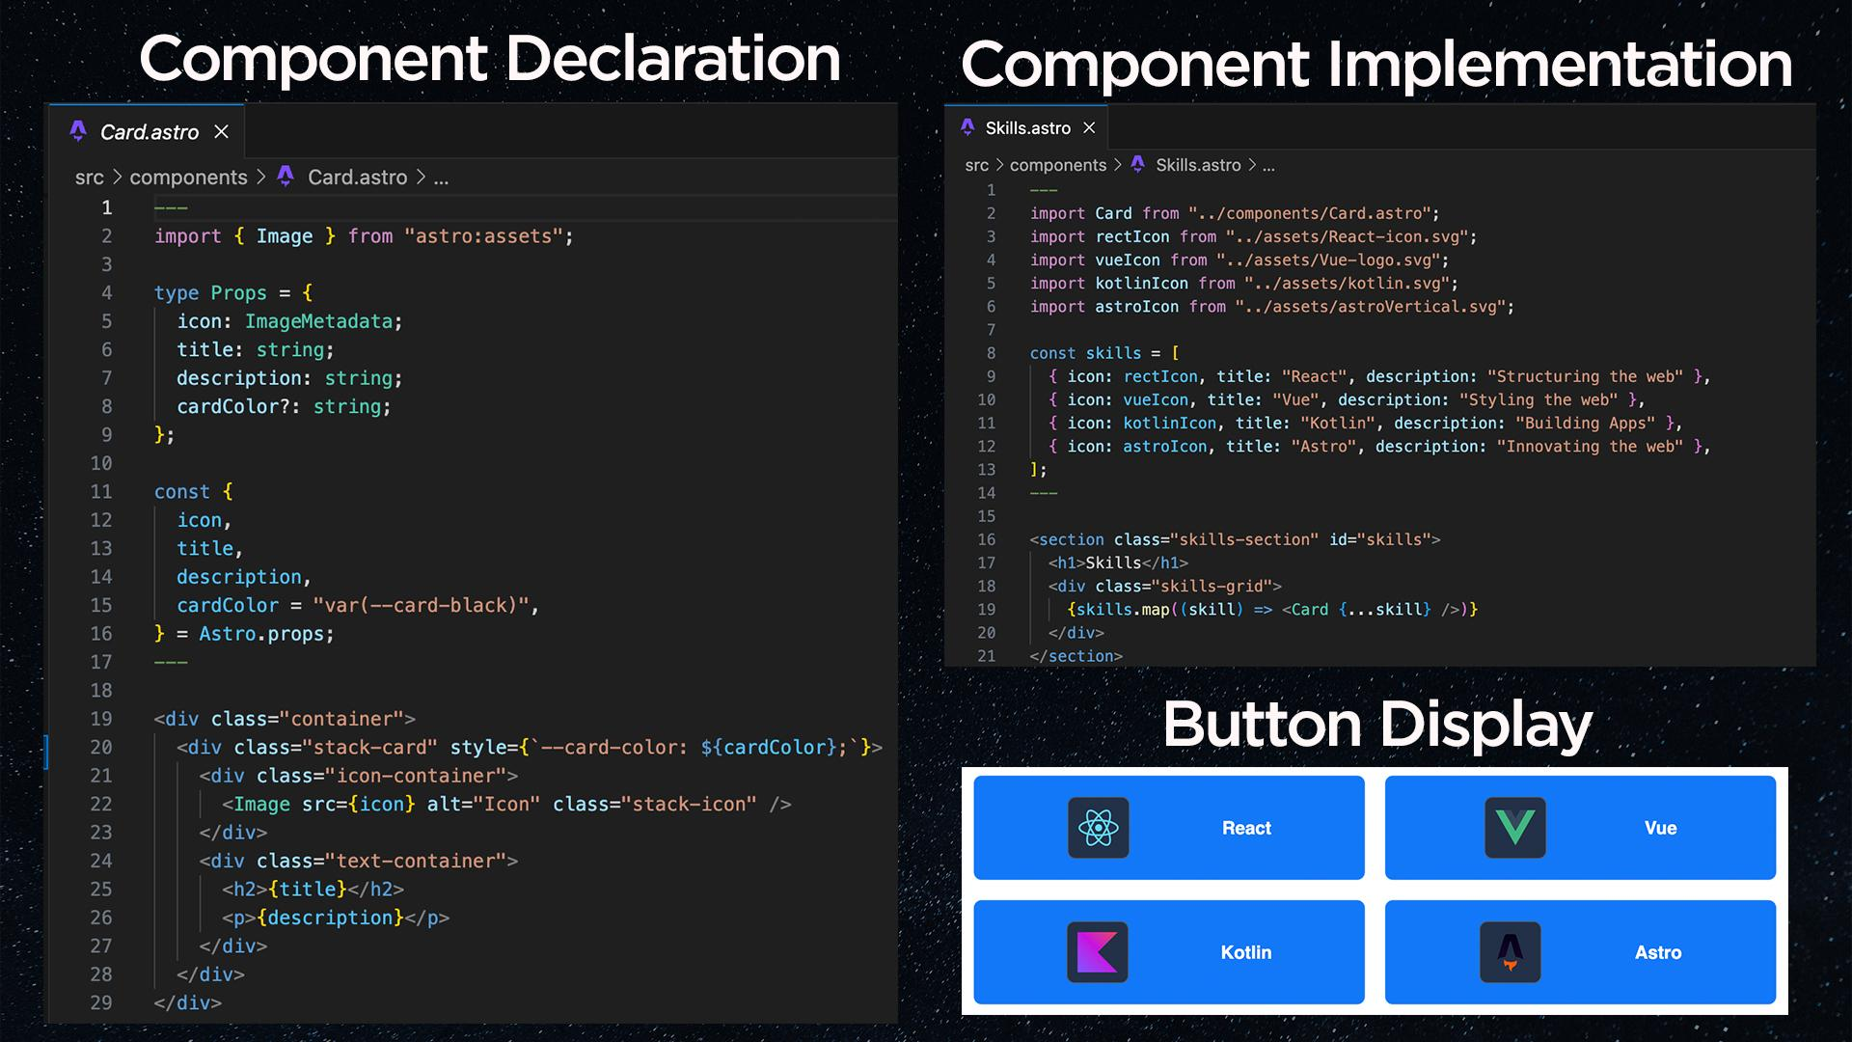

Slide 14


Slide 15

Routing
Astro vs. Traditional SPA
Routing in Astro is file-based, meaning the structure of your src/pages directory determines the routes of your site

Slide 16
Astro vs. Traditional SPA
Islands Architecture

Slide 17
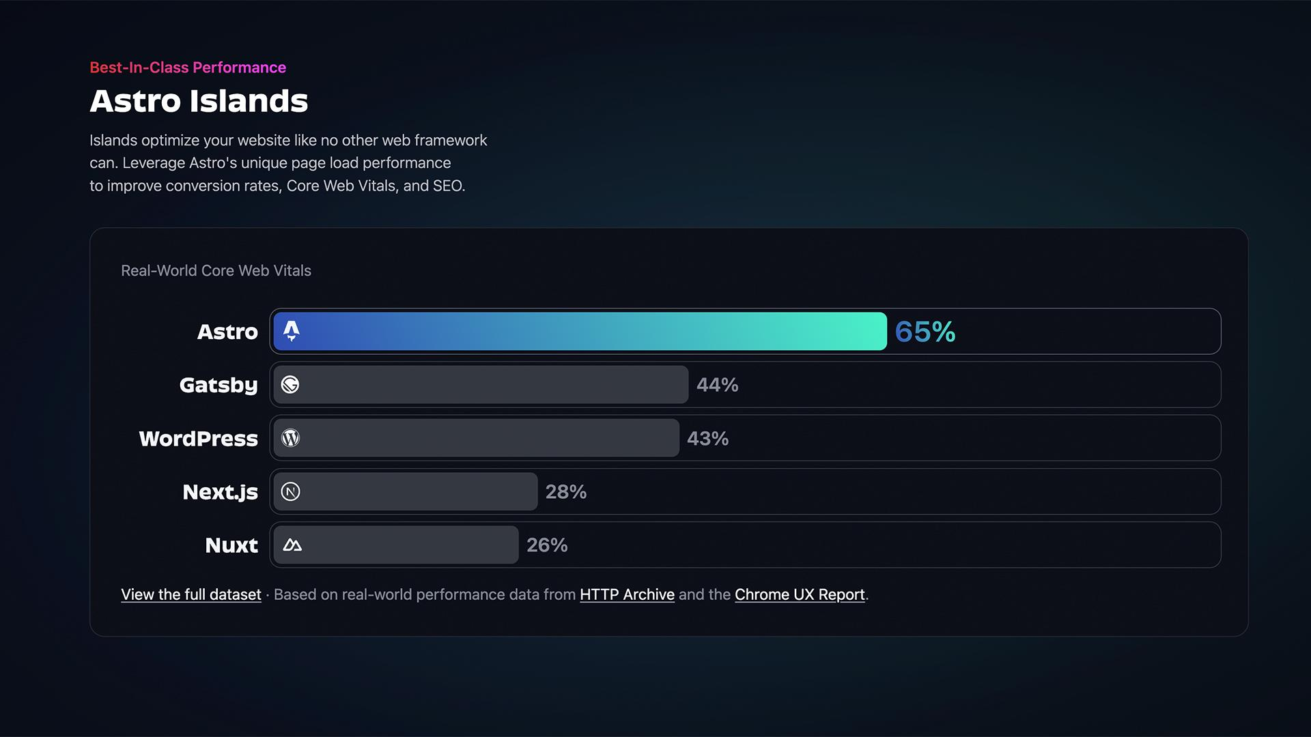

Slide 18
Island Architecture
Island is a component where you can choose where and when to ship client side Javascript.
The longer this process takes, the longer users have to wait. Astro fixes this by only loading the parts of the page that need to be interactive, while the rest stays as simple HTML.
This method, called partial hydration, makes Astro’s "Island architecture" faster than traditional single-page apps because users don’t have to wait for everything to load before they can start using the page.
Astro vs. Traditional SPA

Slide 19
What is hydration?
Astro vs. Traditional SPA

Slide 20
Island Architecture - Hydration
The server sends HTML to the browser.
The browser downloads JavaScript to make the page interactive.
The entire page is processed, even if some parts don’t need interactivity.
This takes time, making the page feel slow.
Astro vs. Traditional SPA

Slide 21
Island Architecture - Partial Hydration
The server sends HTML to the browser.
Instead of hydrating the whole page, only specific interactive components are hydrated when needed.
Static parts of the page stay fast and lightweight.
Astro vs. Traditional SPA

Slide 22
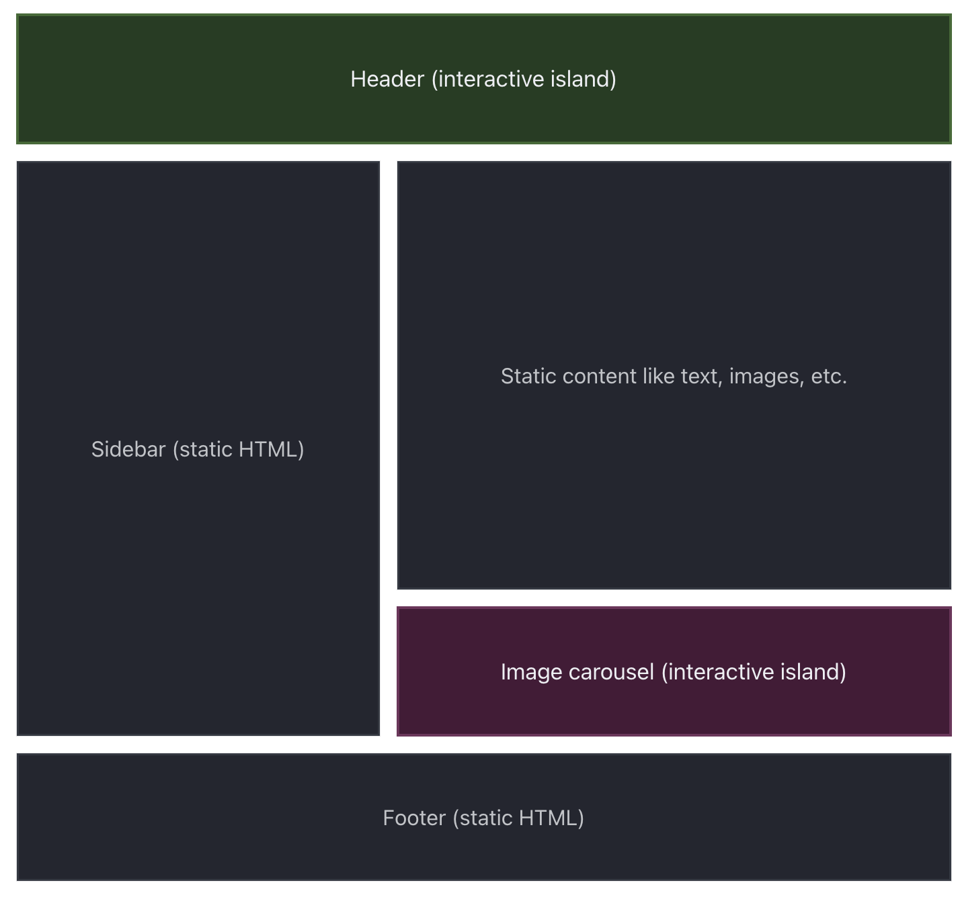

Client Islands
Turning any static UI component into an interactive island requires only a client: directive. Astro then automatically builds and bundles your client-side JavaScript for optimized performance.
Astro vs. Traditional SPA
Source: Islands Architecture

Slide 23
Client Islands
Because interaction is configured at the component-level, you can handle different loading priorities for each component based on its usage.
For example, client:idle tells a component to load when the browser becomes idle, and client:visible tells a component to load only once it enters the viewport.
Astro vs. Traditional SPA
Source: Islands Architecture

Slide 24

Server Islands
Add the server:defer directive to any Astro component on your page to turn it into its own server island:
Astro vs. Traditional SPA
Source: Islands Architecture

Slide 25
Server Islands
Server Islands breaks up your page with smaller areas of server-rendered content that each load in parallel.
Your page’s main content can be rendered immediately with placeholder content, such as a generic avatar until your island’s own content is available.
With server islands, having small components of personalized content does not delay the rendering of an otherwise static page.
Astro vs. Traditional SPA
Source: Islands Architecture

Slide 26
Server Islands - Benefits
A good example of benefit and usage of an server island for an e-commerce storefront.
The store products listing for the main page is usually always changing, so using server islands for these product components would be a good choice, so they can
load faster, while you can load things like user profile and user name using client islands.
Astro vs. Traditional SPA
Source: Islands Architecture

Slide 27
Islands Architecture
Astro vs. Traditional SPA
Source: Islands Architecture: Jason Miller

Slide 28
Islands Architecture
Example with Astro
Astro vs. Traditional SPA

Slide 29
Who Uses It
https://www.ikea.com
https://www.porsche.com
https://www.michelin.com/
https://firebase.blog/
https://nordvpn.com/
https://react.gg/
Astro vs. Traditional SPA

Slide 30
Astro vs. Traditional SPA
Conclusion

Slide 31
Conclusion
If you build a 100% static website using React (or any other frontend framework), Astro can strip away all JavaScript and send only plain HTML and CSS to the browser. This means your site loads super fast, without any unnecessary JavaScript running on the client.
So, if you need super fast static websites, Astro is a great choice.
Astro vs. Traditional SPA

Slide 32
Resources & Information
Astro vs. Traditional SPA
Astro website: https://astro.build

